Slide 1
BDX fields

Slide 2
There are 3 tables .
1. subdivsion – community - builder
2.plan - flor plan
3.spec – homes - sale

Slide 3
1.Community
SubdivisionNumber
SubdivisionName
Street1
City
State
ZIP
AreaCode
Prefix
Suffix
Email
SubDescription
SubImage

Slide 4
2. Plan
PlanName
BasePrice
BaseSqft
Baths
HalfBaths
Bedrooms
Garage
Description
ElevationImage
PlanWebsite

Slide 5
3. home
SpecStreet1
SpecCity
SpecState
SpecZIP
SpecCountry
SpecPrice
SpecSqft
SpecBaths
SpecHalfBaths
SpecBedrooms
SpecGarage
SpecDescription
SpecElevationImage
SpecWebsite

Slide 6
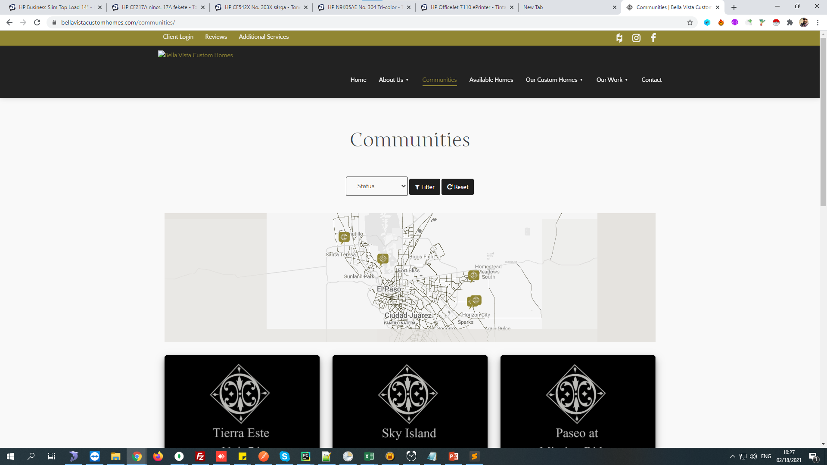
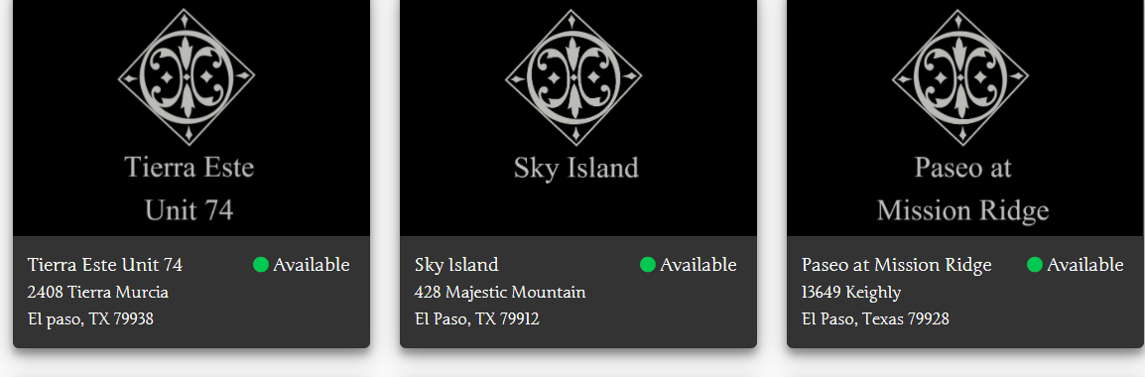
1. find out community
Link : https://bellavistacustomhomes.com/communities/

Slide 7
Community
First of all you have to find community
Community – subdivision
If community is not in site then take it as a fake community
community is required

Slide 8
Community details
Community details :
SubdivisionName - community name
SubdivisionNumber - you have to create using subdivison name (md5) : if community is fake then put it blank('')
Street1 - from address
City - from address
State - from address
ZIP - from address (must be 5 digit : if notn availble put it 00000)
AreaCode - first three digit of mo.no
Prefix - second three digit of mo.no
Suffix last three digit of mo.no
Email - if not available then find it on google or you can get it on facebook profile
SubDescription - required : if not available then put any description from site
SubImage - image
builderNumber = "368759869325853965572281810310" : it is available on sheet

Slide 9
Community rules
State - 2 CharacterOnly
ZIP Must be Only Digits (Rule to be check for Countries where Codes are Alpha-Numeric)
If zip is not available at anywhere take it as 00000
image URL Must be start with "https:" or "http"
If address is not available in community do not consider it as a community

Slide 10
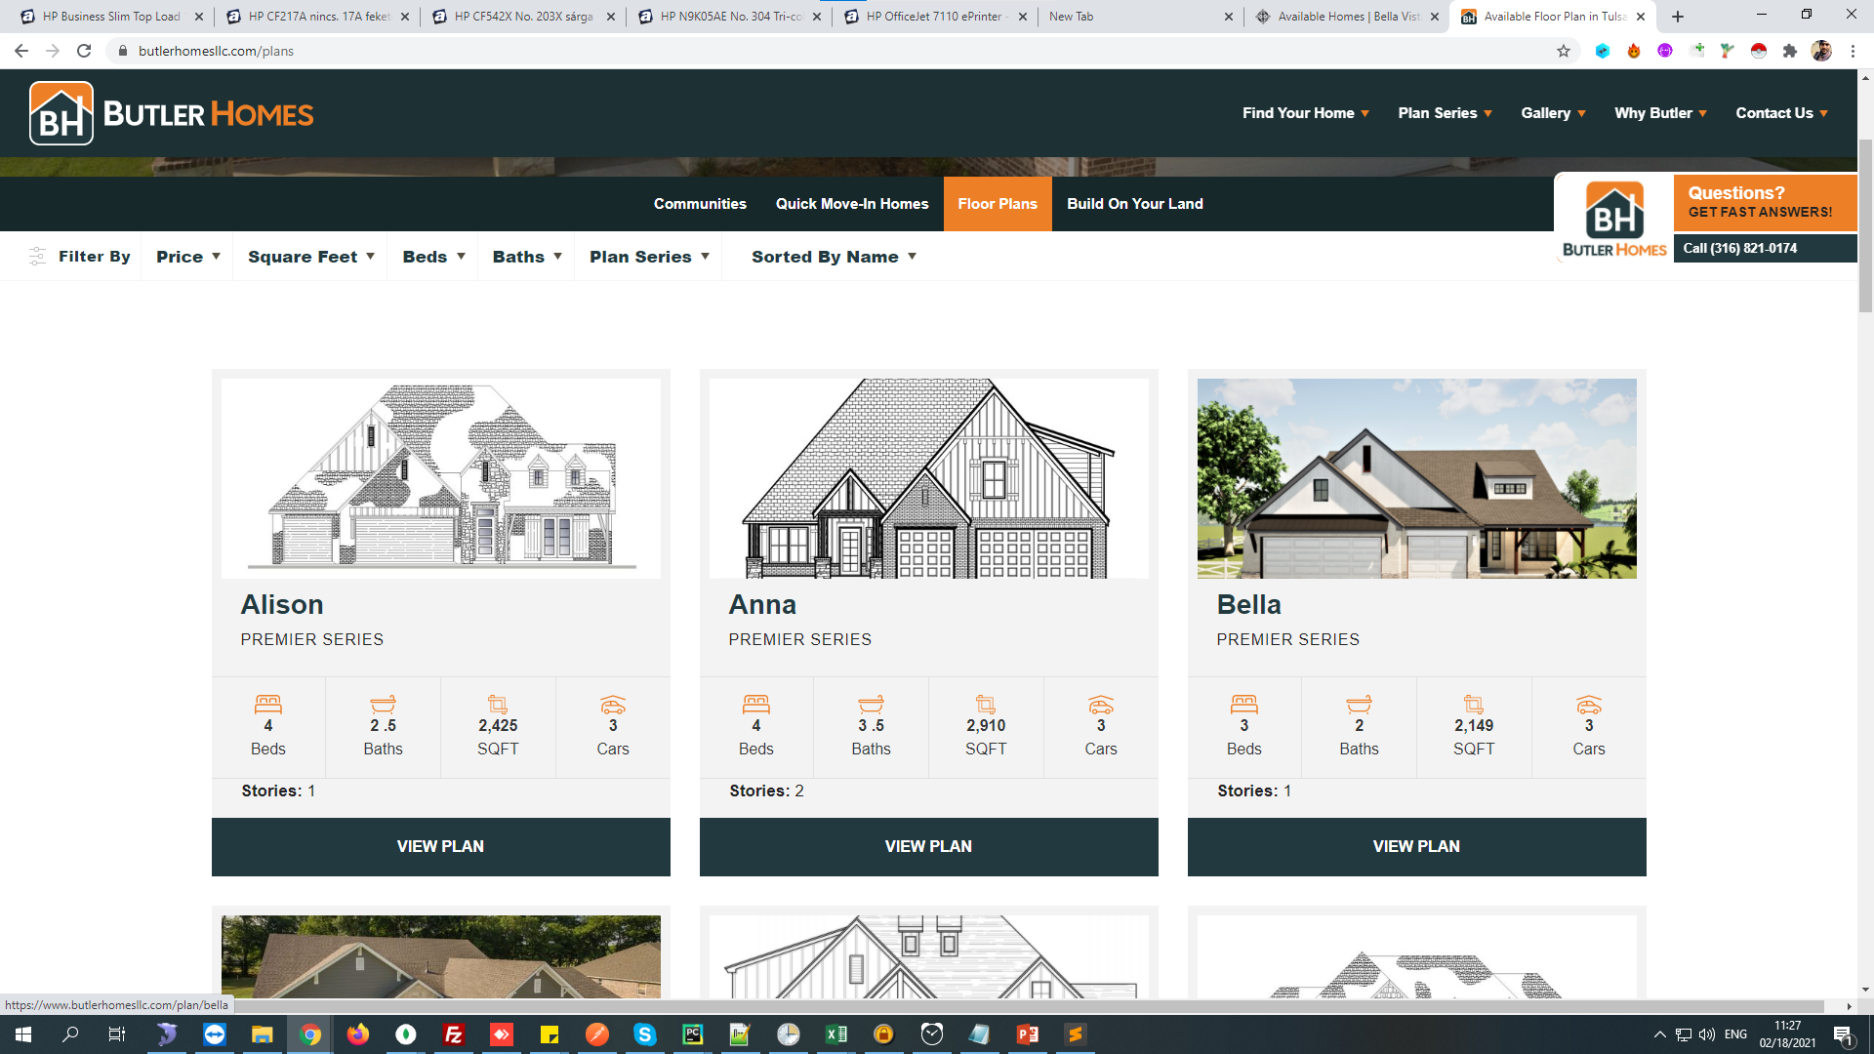
Floor Plan
You next function is a floor plan

Slide 11
Link : https://www.butlerhomesllc.com/plans
Floor plans Fileds :
PlanName = PlanName which is available on site (title)
BasePrice = BasePrice – which is available on site
- Values must be between 40000 and 20000000.
BaseSqft = BaseSqft
- Must be integer and Must be between 500 and 14000
Baths = Baths
HalfBaths = HalfBaths
-If bath is 2.5 then set 2 as a full bath and 1 as a half bath
-If bath is 2 then set 2 as a full bath and 0 as a half bath

Slide 12
Floor plans
Bedrooms = it is available on site
Garage = it is available on site
- only have 1 decimal place (not "2.00" we want "2.0")
Description = from site if its not available set another from site
ElevationImage = from site
-if 500 images found then take 500 images
PlanWebsite = response url
Only export plan/spec price if 0 or $40,000 or more
If baths and bad is not available then do not consider as a floor plan
If ‘sold’ in floor plan do not consider it as a floor plan

Slide 13
Floor plans
Type = SingleFamily
PlanNumber = PlanNumber
unique_number = unique_number have to generate it
SubdivisionNumber = SubdivisionNumber
- SubdivisionNumber = SubdivisionNumber #if subdivision is there #SubdivisionNumber = self.builderNumber #if subdivision is not available
-unique = str(PlanNumber)+str(SubdivisionNumber) unique_number = int(hashlib.md5(bytes(unique, "utf8")).hexdigest(), 16) % (10 ** 30)

Slide 14
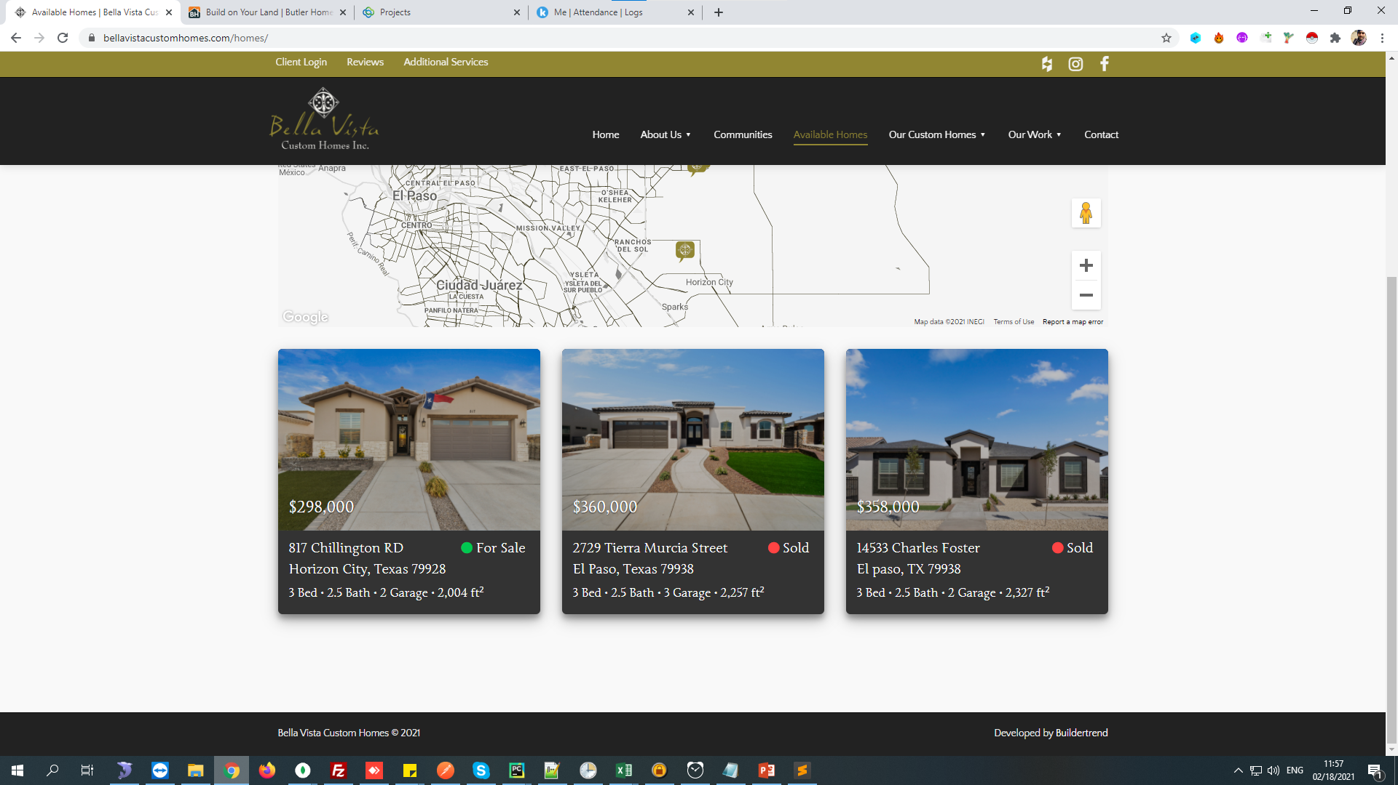
Homes – Spec homes

Slide 15
Spec homes
SpecStreet1 - strret name from address
SpecCity - from site
SpecState - from site
SpecZIP - from site
SpecCountry – from site
SpecPrice – from site
- Values must be between 40000 and 20000000.
SpecSqft = SpecSqft
-Must be between 500 and 14000
- If ‘sold’ in home do not consider as a home

Slide 16
Spec homes
SpecBaths
SpecHalfBaths
- if bath = 5.5
:- SpecBaths – 5
:- SpecHalfBaths – 1
SpecBedrooms
MasterBedLocation
SpecGarage - :
SpecDescription = SpecDescription
SpecElevationImage = SpecElevationImage
SpecWebsite = SpecWebsite

Slide 17
Spec homes
SpecNumber
PlanNum
unique_number
:-
Plans homes | if 'under counstruction' and 'Coming soon' then dont consider it.
subnumber, plannumber, spacnumber | Must Be UNIQUE

Slide 18
Mapping , xml Genrate

